Slide 1
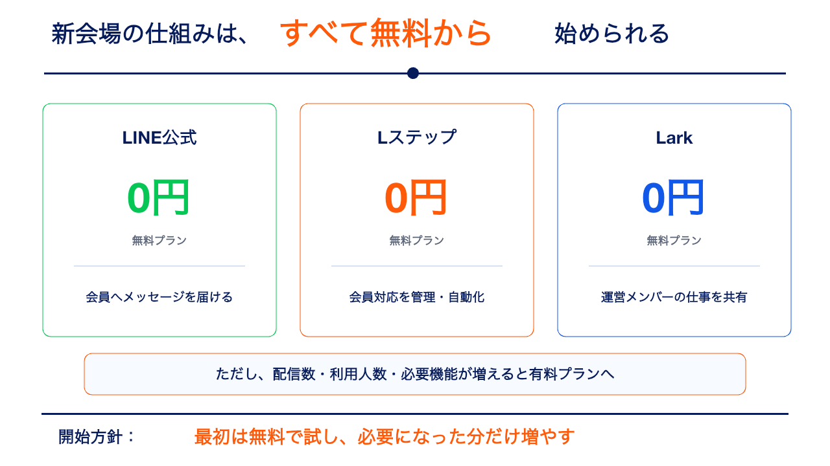
Notes:
[Sources]
https://www.lycbiz.com/jp/service/line-official-account/plan/
https://linestep.jp/lp/01/plan.html
https://www.larksuite.com/ja_jp/plans
[/Sources]

Slide 2
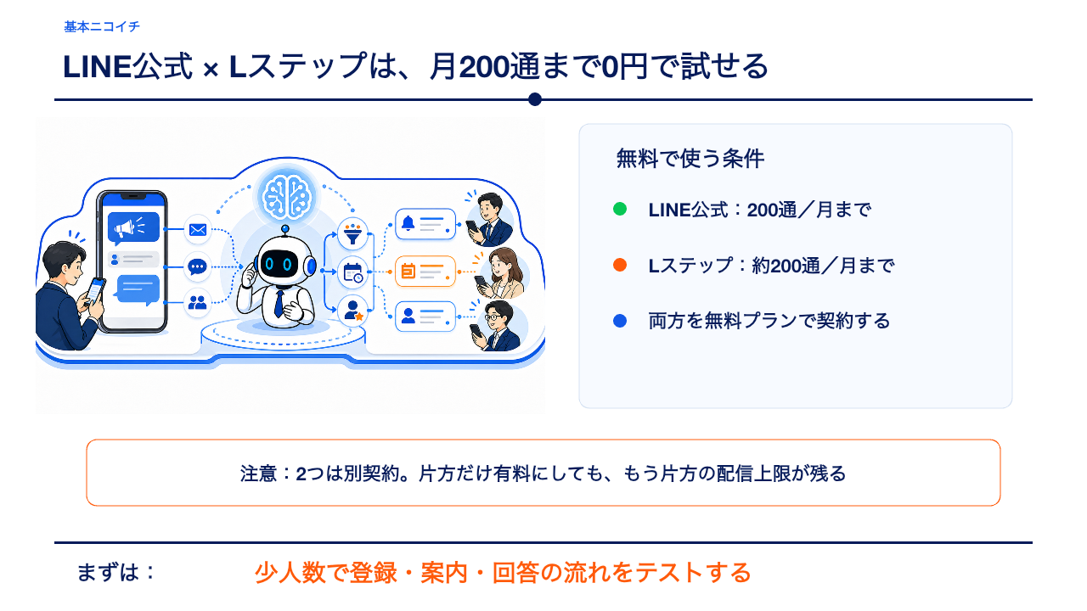
Notes:
[Sources]
https://www.lycbiz.com/jp/service/line-official-account/plan/
https://linestep.jp/lp/01/plan.html
Generated visual: OpenAI image generation, 2026-08-02
[/Sources]

Slide 3
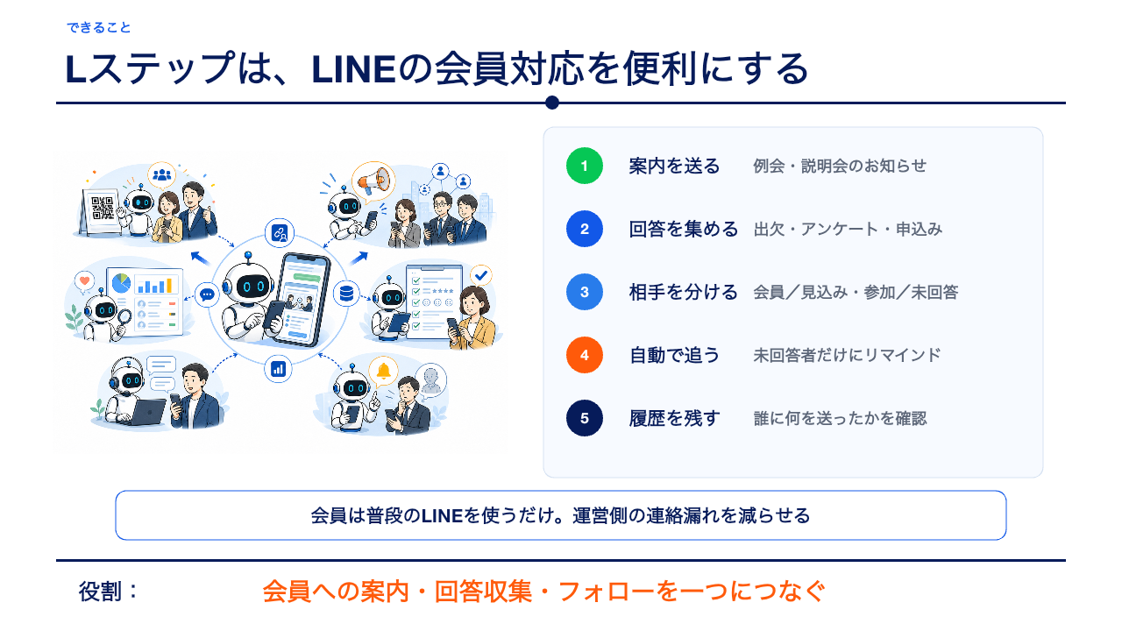
Notes:
[Sources]
https://linestep.jp/lp/01/features_top.html
Generated visual: OpenAI image generation, 2026-08-02
[/Sources]

Slide 4
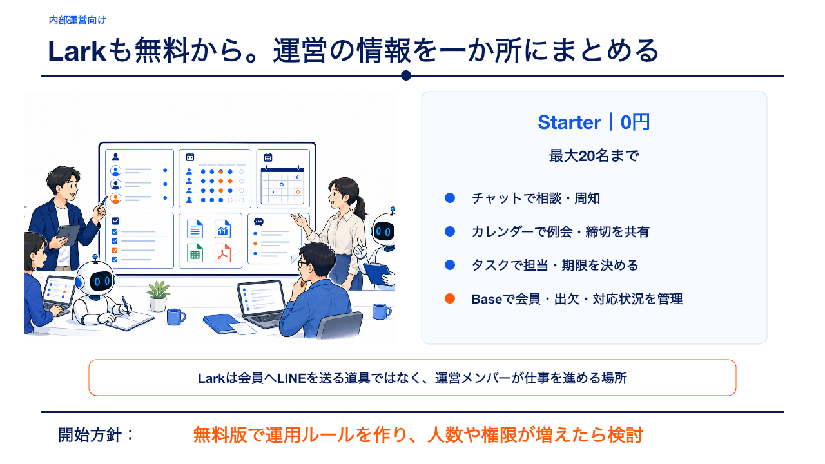
Notes:
[Sources]
https://www.larksuite.com/ja_jp/product/overview
https://www.larksuite.com/ja_jp/plans
Generated visual: OpenAI image generation, 2026-08-02
[/Sources]

Slide 5
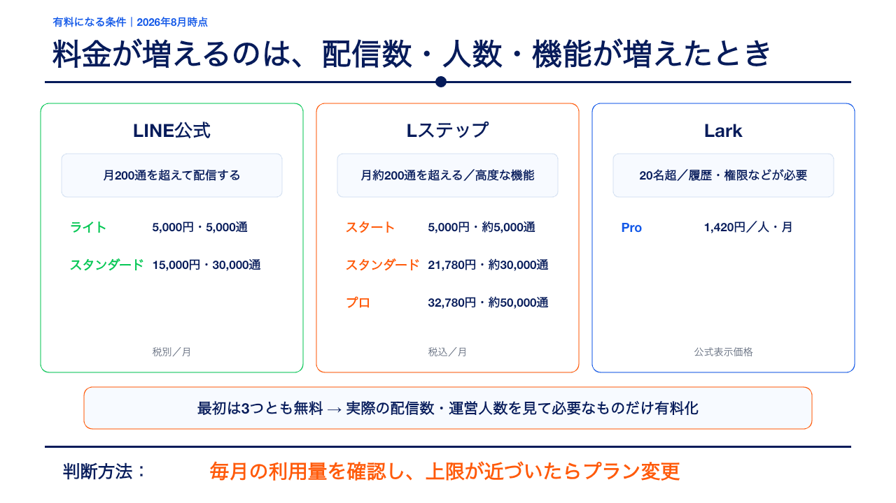
Notes:
[Sources]
https://www.lycbiz.com/jp/service/line-official-account/plan/
https://linestep.jp/lp/01/plan.html
https://www.larksuite.com/ja_jp/plans
[/Sources]

